Slide 1
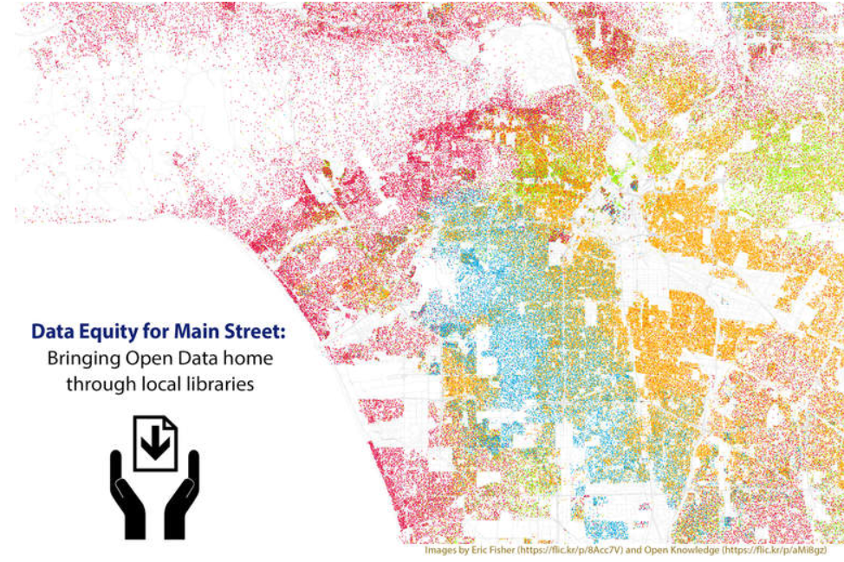
Unlocking the Power of Open Data
Class 1

Slide 2
What do they have in common?
A parent searching for quality daycare
A sister who wants to convince city council to support a new park
A neighbor writing a grant for a school
A small business owner whose product would benefit from using local transportation data
A community journalist telling a story about your neighborhood
Notes:
Class 1a: What Brought You Here?
Estimated Time: 10 minutes
Learning Objective: Demonstrate curiosity and motivation to learn more
Discussion: In this section you will be welcoming students to the class, finding out why they are here, and assessing the level of understanding around open data.
Activities:
Welcome and introduction
Welcome students to the library.
Ask them the teaser questions “What do they have in common”

Slide 3
Open Data Can Help!
Notes:
Class 1a (cont’d)
The answer to the teaser question “What do they have in common?” is… Open Data Can Help!

Slide 4
What brought you here?
Notes:
Class 1a (cont’d)
2. Collect background on class participants. Ask the class a few of the questions below to find out more about their level of knowledge and what brought them to the class. Record the answers if possible. The amount of time spent on this activity may depend on how many people are in the class.
How many of you have heard of open data before seeing this class announcement?
Does anyone know what open data is? (if yes) Can you tell us what your definition and understanding is?
Why did you come to this class?
What do you hope to learn from taking this series of classes?
Does anyone have a specific question they’re hoping open data will help them answer?

Slide 5
The Big Picture
This is an introductory class. We’ll talk about a new tool - open data - you can use to help answer your questions.
This is the first of four classes. In other classes you’ll:
Answer questions using open data;
Make charts and maps;
Learn tips for analyzing data; and
Find out how to give feedback and improve open data.
Notes:
Class 1a (cont’d)
3. Give a breakdown of what this class series is and why it’s important:
This is an opportunity to learn about new tools and to better understand what’s taking in place in your community
We will first explore what open data is, where you can find it, how to use it, and why it’s important to give feedback to the people and organizations that publish it.
There are four one- to two-hour classes, including this one, which will set you on the path of becoming an open data expert. At the end of this class you will have a solid understanding of what open data is, see examples of how and where it is used, be able to form open data questions, and be able to find open data on your own.

Slide 6
Objectives
Define open data and understand some ways in which it is used.
Explain whether or not datasets meet open standards.
Brainstorm questions that can be answered through open data.
Explain where open data can be found. Find open data by yourself.
Notes:
Class 1a (cont’d)
4. List the objectives of the class.

Slide 7

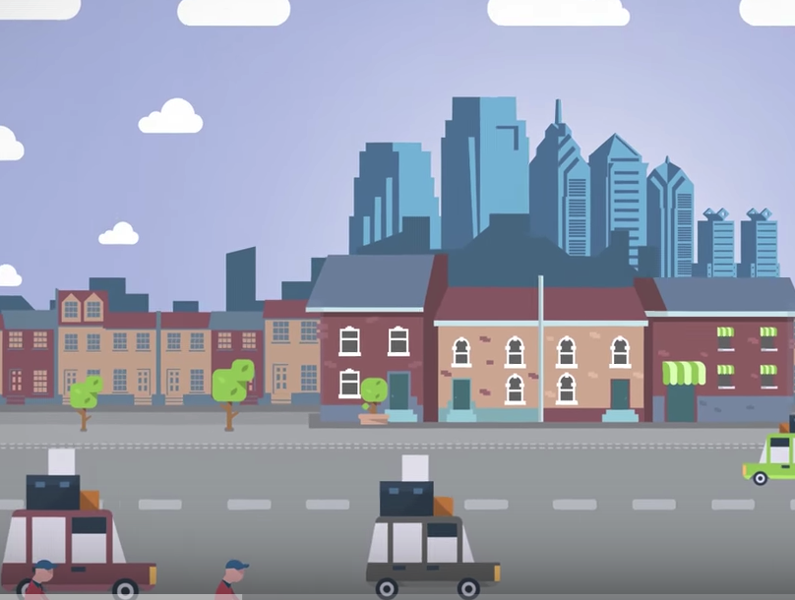
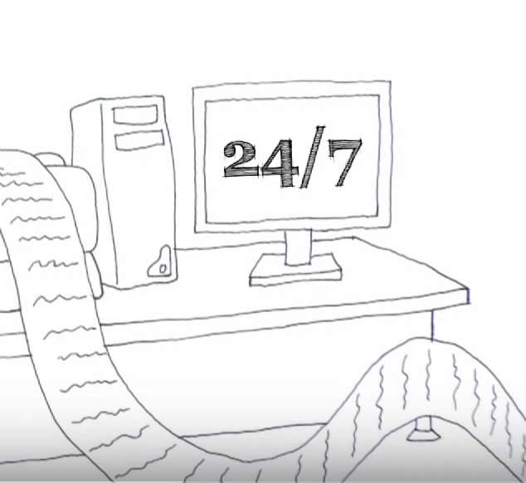
A Short Introduction
Video 1: How you use government data every day.
Video 2: What will you discover with open data?
Video 3: What is open data?
Notes:
Class 1b: What is Open Data?
Estimated Time: 30 minutes
Learning Objective: Define open data. Explain whether or not datasets meet open data standards.
Discussion: In this section you’ll begin to dive into the definitions and standards that separate open data from other data sets. You’ll cover an in-depth explanation of open data, share examples of open data sets, and then have the class evaluate datasets, sharing why they are or are not open.
Activities:
A brief introduction:
Choose one of the videos here to show your class:
Video 1: From CNN. Broad-based (1:49, requires watching a short ad) http://money.cnn.com/2017/04/11/technology/government-open-data-life-decisions/index.html
Video 2: From City of Philadelphia. Has some specific Philadelphia information, but explains open data broadly (2:03)
https://www.youtube.com/watch?v=SpOD0ab1T8A
Video 3: From County of Grande Prairie, No. 1 (Canada). Is general and has a more rural orientation. (3:02)
https://www.youtube.com/watch?v=PzWpcVzuwV0

Slide 8

What is Open Data?
“Open data and content can be freely used, modified, and shared by anyone for any purpose.” http://opendefinition.org/
Notes:
Class 1b: What is Open Data?
2. Provide the open data definition. If someone has already given a definition in class you can let the students know that you’re going to expand upon that and go into more detail.
Most definitions agree on the key points listed in the Open Definition: “Open data and content can be freely used, modified, and shared by anyone for any purpose.” What does this mean?
3. Write each element on the whiteboard or large post-it paper, or bring it up on the screen. Together you’ll go over each of the key elements that define open data. Write the key elements down on the whiteboard or post-it notes. The class will refer to them later when reviewing data sources to see if they are open or not. (Suggested time: 5 min)

Slide 9
can be freely used …
“Open data and content can be freely used, modified, and shared by anyone for any purpose.”
Notes:
Class 1b (cont’d): What is open data?
#3 Elements of the definition
Freely used
Open data should not cost any money to access
Assumes ability to access it
No restrictions on use
The data can be shared with other people and no requests for use or copyright permissions are needed to share open data.

Slide 10
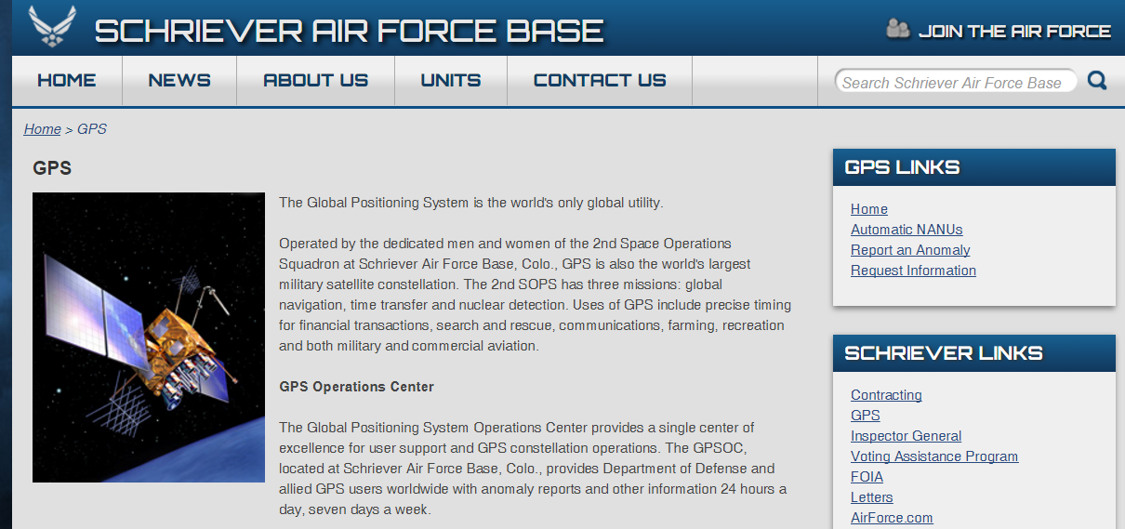
Example of freely used:
Global Positioning System (GPS) data
http://www.schriever.af.mil/GPS/
Notes:
Class 1b (cont’d) : What is open data?
#3 Elements of the definition: Example of “freely used”
EXAMPLE: Maps: Have you used a map that shows you where you are and gets to you where you’re going? You’ve used GPS. GPS stands for Global Positioning System and is provided for free through the U.S. Department of Defense.

Slide 11
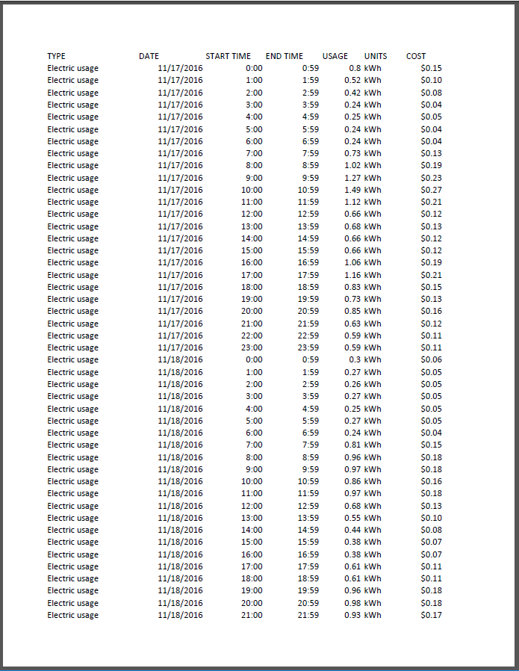
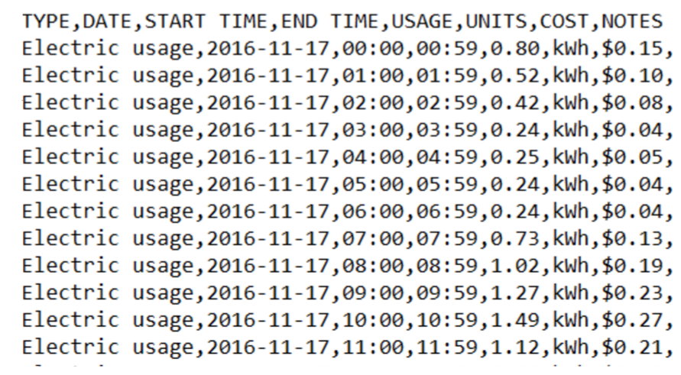
Open Data is also machine readable
PDF CSV
Notes:
Class 1b (cont’d) : What is open data?
#3 Elements of the definition: “freely used”
Machine Readable
Data is made in a format that your computer can read such as csv file. (Show an example of a csv file and one of a pdf. Explain that the pdf is a locked document and the computer is unable to read any of the information on the page, even though you can.)

Slide 12
can be … modified
“Open data and content can be freely used, modified, and shared by anyone for any purpose.”
Notes:
Class 1b (cont’d): What is open data?
#3 Elements of the definition
Can be… modified
Able to be modified and used for any purpose
No restrictions on how the data is used and can be modified to be used in new ways. It might be combined with other data to create something new and useful.
The data can be used for educational purposes but can also be used by businesses to create services that may be commercial and may require fees. The data itself is free and can be used for any purpose.

Slide 13
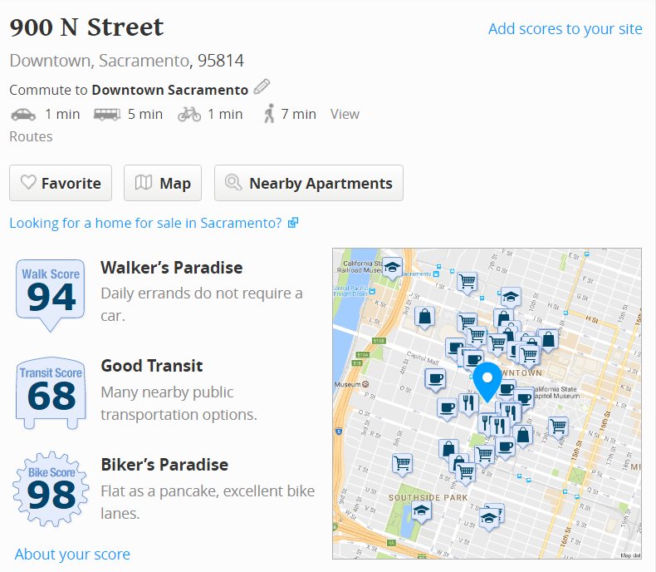
Example of can be modified
Walkscore.com
https://www.walkscore.com/bike-score-methodology.shtml
Notes:
Class 1b (cont’d): What is open data?
#3 Elements of the definition Example of “can be modified”
Neighborhood Walkability: WalkScore bike methodology uses data made available from local governments, the National Elevation Database from the US Geological Service, and commute data from the U.S. census. It creates an image like this. If you have time, try putting in an address and see what it says about bikeability or walkability.

Slide 14
shared by anyone for any purpose
“Open data and content can be freely used, modified, and shared by anyone for any purpose.”
Notes:
Class 1b (cont’d) : What is open data?
#3 Elements of the definition: Shared by anyone for any purpose
i. When a government or organization makes data “open” it allows anyone to use it - for any purpose. Open data publishers often include a license that clearly tells you that you can use the data. While you can use it for any purpose, they sometimes they ask you to attribute the original source or to use the same license for any new product you make.

Slide 15


How do you know data can be shared by anyone for any purpose?
Look for these images…
These licenses tell you it’s ok to use the data
Notes:
Class 1b (cont’d) : What is open data?
#3 Elements of the definition:
Shared by anyone for any purpose
ii. Open Data Licenses will often include these icons. The most well-known of these is the Creative Commons license. The other license, which is more recent and was designed specifically for databases, is from the is from the Open Data Commons. One such example of a license is called a Creative Commons license. (You can refer students with more interest in this to Handout 4 Open Licenses for Data and Content or a Creative Commons video.)

Slide 16
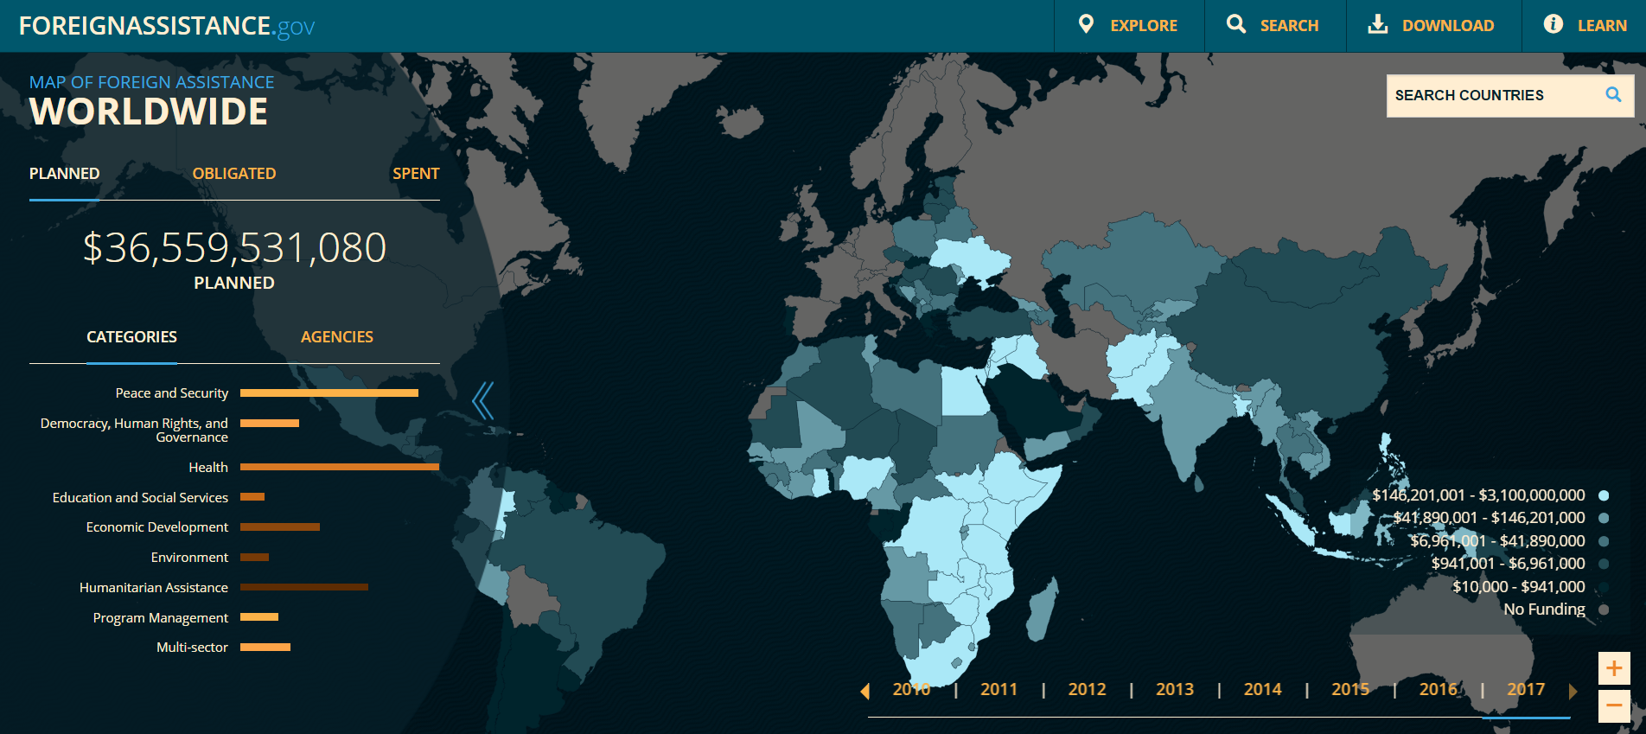
Let’s Look for a License
Notes:
Class 1b (cont’d) : What is open data?
Elements of the definition: c. Shared by anyone for any purpose: Licensing
iii. Show an example of a license on a live website.
ForeignAssistance.gov: The U.S. Government collects foreign assistance spending information from several departments and makes them available through this tool. The map and graphic visualizations are supplemented with machine readable data which is available via the “Download” option in the top menu. License information is displayed beneath the data download options.

Slide 17
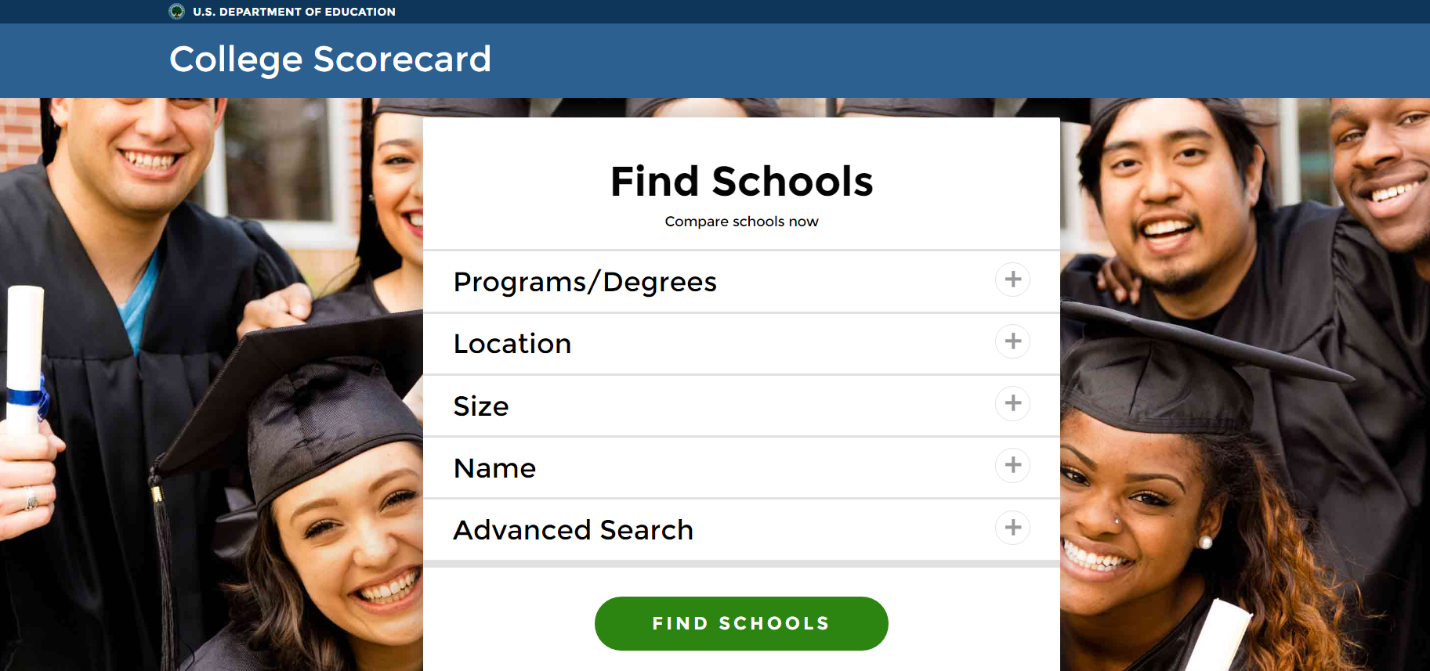
Example of Open Data: https://collegescorecard.ed.gov/
Notes:
Class 1b (cont’d) : What is open data?
#4 Examples of open data
Share one or more examples of open data.
Education: Parents and community groups can use the data in school quality report cards to compare their school to others.
College Scorecard: U.S. Department of Education: Dataset, Interactive. The site allows visitors to sort and filter their search results to easily compare schools and decide which college makes the most sense when considering the
location, typical costs, average student loan amount, student's ability to repay their loans, and their future earnings. You may wish to do a search for your location and limit by various factors such as 2 year vs. 4 year degrees and public vs. private schools. Compare costs and anticipated salaries for the schools.
Note to instructor:
To download the data from the College Scorecard site, select the College Scorecard Dataset link at the bottom to learn more about the underlying open data that powers this site. Scroll down to the heading “Download the Data”.]
If you have trouble accessing College Scorecard,but want to use the data, you can view the data from data.wa.gov. You can find the data here, on data.wa.gov.
Other examples include:
If you want to highlight some businesses that use open data to create their product, see: https://www.data.gov/impact/

Slide 18
Commonly-Published City and State Data
Crime, 911, 311, Code Enforcement
Zoning
Budgets, Contracts, Spending
Property Assessments and Deeds
Transit Safety, Schedules, Timeliness
Parcels and Address Points
Restaurant Inspections
Construction Permits
School funding and demographics
Vehicle Crashes
Population projections
Immunization rates and other health outcomes
Daycare, Assisted Living and Nursing Home Safety
Water, Broadband, Electricity Information
Check out http://us-city.census.okfn.org/ and https://census.usopendata.org/ for more details.
Notes:
Class 1b (cont’d) : What is open data?
#4 Examples of open data
Show the commonly-published data from local, state and national sources. Most of these examples are from http://us-city.census.okfn.org/ and https://census.usopendata.org/ .

Slide 19
National Resources (www.data.gov)
U.S. Census: Age, Education, Income, Gender, Race, Marital Status, Commute times, Rent/Own, Home Value, Employment by… Neighborhood, City, County, State, National
Consumer Complaints
Fruit and Vegetable Prices
Storm Prediction Reports
Product Recalls
School crime and safety
Hospital charges for common services
College financial aid, graduation rates
Teacher shortage areas
Medical professional shortage areas
Private school data
Chronic disease estimates for more than 500 cities
Local air quality data
Notes:
Class 1b (cont’d) : What is open data?
#4 Examples of open data
The Federal Government’s open data site is https://www.data.gov

Slide 20
Insert example here
Notes:
Class 1b (cont’d) : What is open data?
#4 Examples of open data
Other examples (continued)
If the local community has had an open data success, include that example here. (Note: This is covered in the Librarian training.) For help contact your state’s Open Data Program, Chief Data Officer or the Data-Equity team. Examples might include:
Crime: Crime statistics allow people to compare their neighborhood to another and advocate for more or different resources from the police.
Transportation: data that contains bus or train schedules can be merged with other information to help residents better plan their travel.

Slide 21
Open data or not?
Notes:
Class 1b: What is open data?
#5 Open data or not?
Open Data or Not? View the slides with data examples and let the group decide whether or not they meet the criteria for open data. Discuss why or why not.

Slide 22
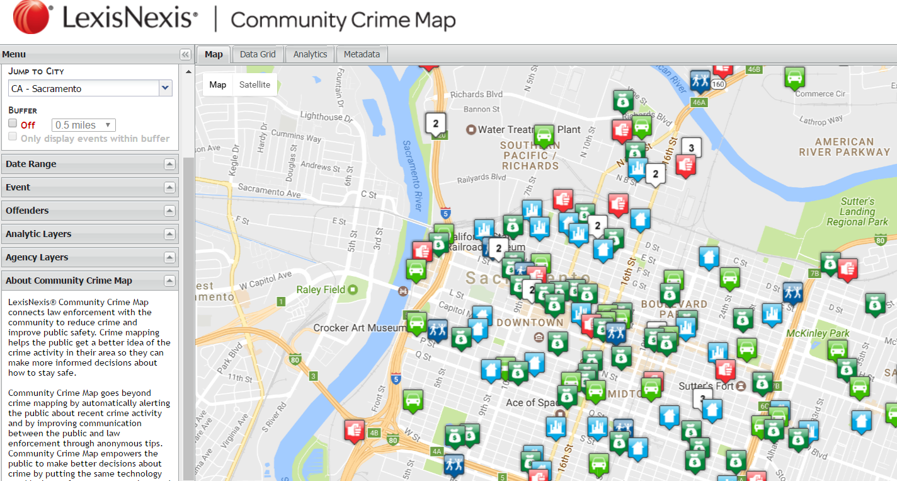
Crime data (Anne, comparison of two sites, https://communitycrimemap.com/ and City of Sacramento data portal)
https://communitycrimemap.com/
Notes:
Class 1b: What is open data?
#5 Open data or not? Example 1
Not open data (its license is restrictive and you can’t download it) though certainly still useful. Check to see if your community makes crime data available. Open data can be used for commercial purposes, but it may no longer be “open” once it’s part of a new product.
It would be useful to check to see if your community makes crime data available, and if so, compare it.

Slide 23
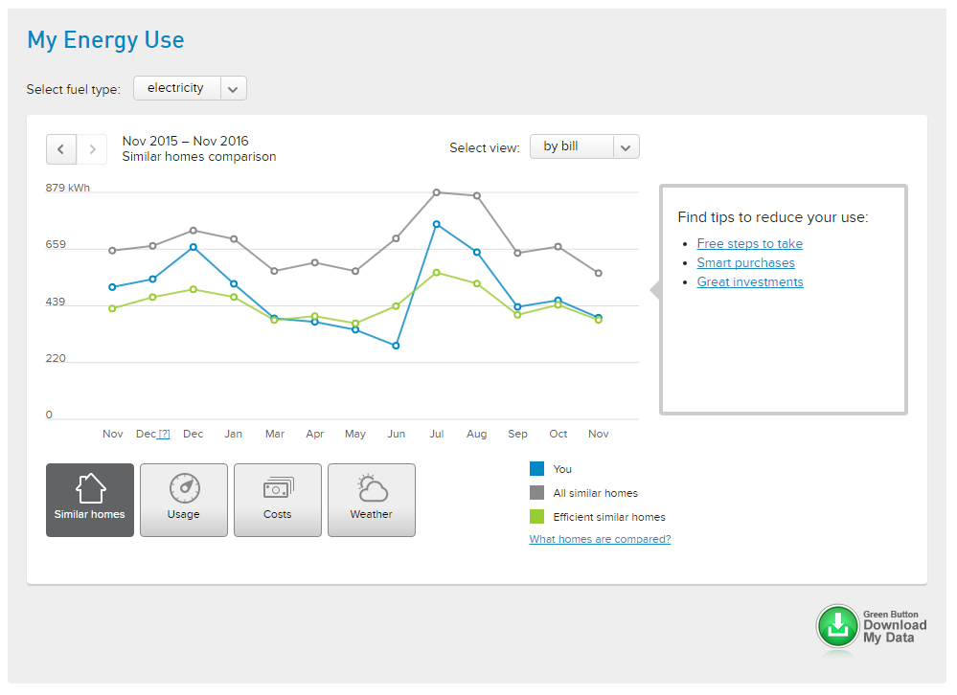
Notes:
Class 1b: What is open data?
#5 Open data or not? Example 2
Energy use for someone’s home - Not technically open data (you have to log in to access it, but it is open and available to download for that person). (This is also a good opportunity to compare the data formats: line graph, Excel on the next slide and csv on the slide after Excel example.)

Slide 24
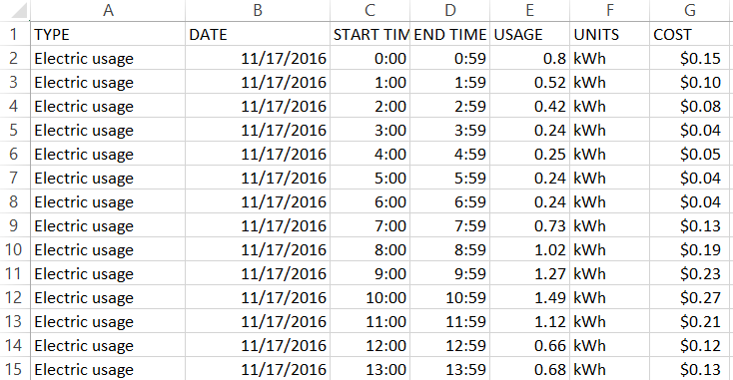
Notes:
Class 1b: What is open data?
#5 Open data or not? Example 2
Individual electricity usage viewed in Excel (CSV format)

Slide 25
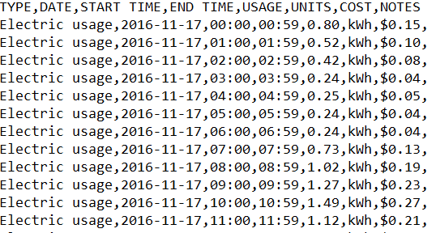
Notes:
Class 1b: What is open data?
#5 Open data or not? Example 2
Another view of the CSV file, this time viewed in a text editor without Excel.

Slide 26
Not exactly open data, but still useful data
The community crime map allows you to view crime, but you can’t download it and so you can’t combine it with other data.
Personal electricity usage SHOULDN’T be open data, except to you. This company makes it available for you to view, download, or modify, but it is not publicly accessible.
We’re focusing on open data, but this useful data may still help you answer your questions.
Notes:
Class 1b: What is open data?
#5 Open data or not?
Ask the class about what kinds of similar data they already have about themselves or their family. (Examples may include fitbit, calorie counting, height/weight of children in a baby book, DNA, health information, electricity data.)
Good place to mention privacy. Open data isn’t about releasing your personal data publicly. The practices by this energy company are good; it’s your data, so you can download it, but no one else can. Do you know about your other personal data (fitbit, DNA, etc.)?
Provide Community Curriculum Handout 1: Open Data: What is it as a handout for participants to take with them.

Slide 27

What questions can I answer through open data?
Notes:
Class 1c: What Questions Can I Answer Using Open Data?
Estimated Time: 10 minutes
Learning Objective: Brainstorm both institutional (relevant to community) and personal questions that can be answered through open data.
Discussion: The class has just discussed what open data is and reviewed examples of what is not open data. Now it’s time to brainstorm questions that might be answered through open data, both for the community and in their personal lives.
Activities:
Brainstorm institutional/community and personal questions that open data might be able to answer.
Have large post-it notes or a whiteboard available to post responses. Give each person in the class a small stack of post-it notes and a pen or marker. Tell the class they will have two minutes to write as many questions as they can think of. When they’re finished have the class post them on the board. Look at and discuss the questions posted, grouping them together into categories if they are similar.
If the class isn’t giving any answers to the brainstorm you may need to prompt them with questions. Ideas for questions:
Something you’d like to know about your child’s school?
Questions about housing or rental prices?
Crime in your neighborhood?
Weather in your area (hotter, colder or rainier than average)?

Slide 28
Where Can I Find Open Data?
Notes:
Class 1d: Where Can I Find Open Data?
Estimated Time: 15 minutes
Learning Objective: Explain where open data can be found. Find open data by yourself.
Discussion: Why are governments and other organizations releasing data and where are they making it available? Many governments and non-governmental organizations around the world are publishing open data in an effort to be more transparent and (sometimes) to reduce costs. They’re often prioritizing what to publish based on public feedback. So one of the items we’ll cover in these classes is how to give feedback if you’re not finding the data you need.
Many cities and states, and the federal government have been placing their open data online on one website, often called a portal. Sometimes a department or agency has open data, but they have not put it on the portal.

Slide 29
[Insert local, state or federal open data portal or site]
Notes:
Class 1d (cont’d)
Activities:
Start by showing the nearest city/county/region open data portal (if you have one). If your city doesn’t have an open data portal, refer to the list of local resources in Community Curriculum Handout 2: Where can you find open data? (Trainers personalize this handout during the Librarian Training or on their own.)
Show how to find that data portal by performing a Google search. “Your city open data” is a good search query. Talk about looking at the web address as an indicator of finding a government open data portal. Often it will look like “data.yourcity.gov”.
Refer back to the questions the class brainstormed. Can they think of how to form a search query to get the open data set that will answer their question?
Note: Many areas will see “opendatanetwork.com” listed as the first or second search result. This is website maintained by an open data vendor, Socrata, and uses Census and FBI data to create easy to use visualizations. This is not an open data portal in that it does not contain local or state information released by those entities.
Once you find what you think is an open data portal, use your definition as a guide to make sure it really is open.

Slide 30
Choose Your Own Adventure (2-3 min)
Notes:
Class 1d (cont’d): Where Can I Find Open Data?
4. Using what you know about class participants, choose an open data site that might be of interest. Give the class 2-3 minutes to search on their own and ask everyone to provide one take-away that they learned and share if there was missing information or questions.
Use the discussion to raise the idea that if the open data site could be improved, we all would have an opportunity to give feedback.
Let the class know that charts, graphs and other types of displays are often a great first step. If participants are looking at these types of visualizations and are unsure of some definitions, see if the site has a data dictionary, or glossary. Often, data is already packaged in a way that will make it fairly easy to quickly make charts, graphs, etc. (Next class we will cover downloading and expressing data in different ways.)

Slide 31
Can you do this?
Define open data and understand some ways in which it is used
Recognize whether data is open
Explain where open data can be found
Notes:
Review the objectives for this session.

Slide 32
Next Time…
What’s behind the data? Easy ways to understand if the data has what you’re looking for
Hands-on: Learn how to answer questions using open data (Google Account will be needed)
Notes:
At the end of Class 1 let participants know that they will need a Google Account for Class 2. Let them know that you are available to assist anyone who needs help setting one up.
Ask class members to fill out an evaluation. This will take no more than 5 minutes. Let the class know:
this class is a pilot and we want to know whether the class met your expectations and how we can improve.
We’d like you to answer a few questions to see if the class is the curriculum was able to communicate information well enough.

Slide 33
Thank
You

